Slide 1
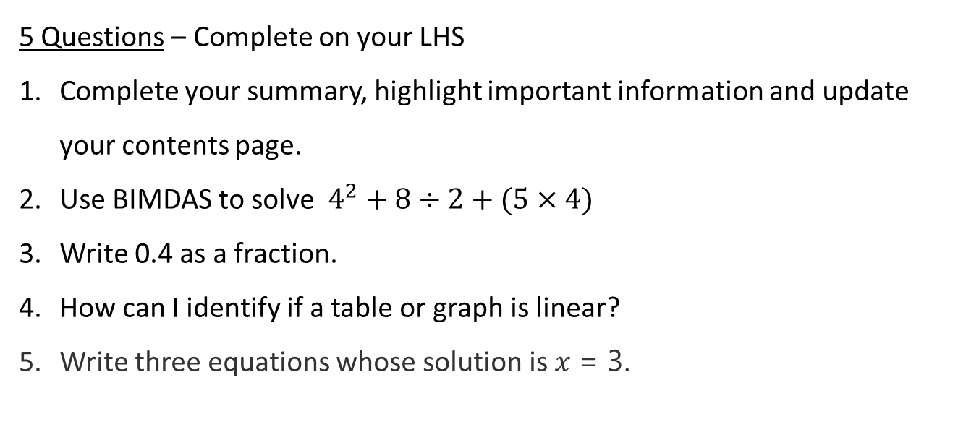
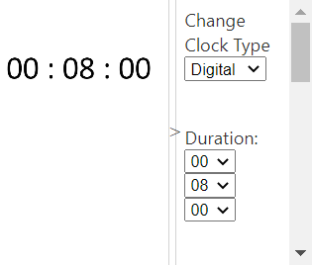
Topic: Finding a rule
Date: XX/XX/2021
EQ – How do you find and use the rule for a linear relationship?
5 Questions – Complete on your LHS
Complete your summary, highlight important information and update your contents page.
Use BIMDAS to solve $4^{2}+8÷2+(5×4)$
Write 0.4 as a fraction.
How can I identify if a table or graph is linear?
Write three equations whose solution is $x$= 3.

Slide 2
24
7
30
Topic: Finding a rule
Date
EQ – How do you find and use the rule for a linear relationship?

Slide 3

24
7
30
Topic: Finding a rule
Date
EQ – How do you find and use the rule for a linear relationship?
All Linear equations can be written in the form;
$$y=Mx+C$$
M =is the gradient
C = the y-intercept (x value at time 0)
x | 0 | 1 | 2 | 3 | 4 | 5 | 6
y | -5 | -3 | -1 | 1 | 3 | 5 | 8
2
2
2
2
2
2
M = 2 as the y values increase by 2 each time
C = -5 as the y value when x is 0 is -5
$$y=Mx+C becomes y=2 x −5$$

Slide 4
We try
Your turn to try
x | 0 | 1 | 2 | 3 | 4
y | 2 | 5 | 8 | 11 | 14
x | 0 | 1 | 2 | 3 | 4
y | -6 | -10 | -14 | -18 | -22
M = y intercept =
y = ___x + ____
M = y intercept =
y = ___x + ____
x | 0 | 1 | 2 | 3 | 4
y | 4 | 2 | 0 | -2 | -4
items | 0 | 1 | 2 | 3 | 4
Cost | 3 | 4 | 5 | 6 | 7
M = y intercept =
y = ___x + ____
M = y intercept =
Cost = ___items + ____
p | -2 | -1 | 0 | 1 | 2
t | -2 | -1.5 | -1 | -0.5 | 0
k | -2 | -1 | 0 | 1 | 2
g | 0 | 0.1 | 0.2 | 0.3 | 0.4
M = y intercept =
t = ___p + ____
M = y intercept =
g = ___k + ____

Slide 5
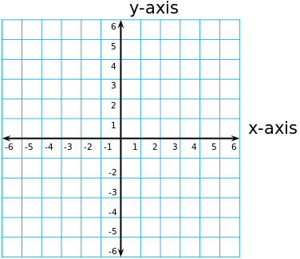
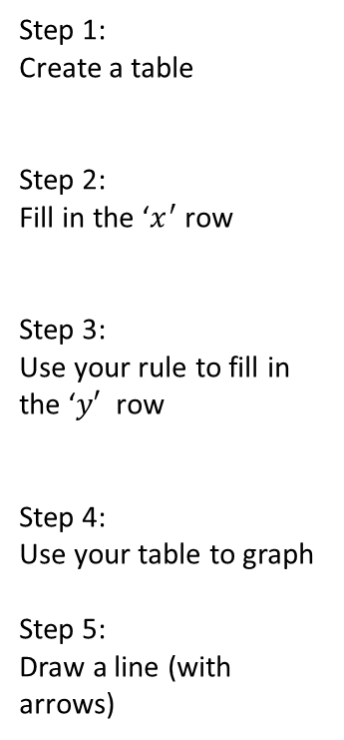
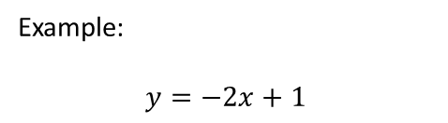
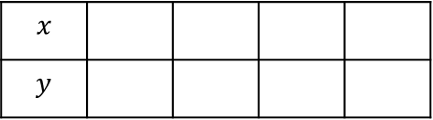
24
7
30
Topic: Linear Relationships
Date
EQ – How do you find and use the rule for a linear relationship?
How do I turn an equation into a graph?
Example:
$$y=−2x+1$$
Step 1:
Create a table
Step 2:
Fill in the ‘$x^{′}$ row
Step 3:
Use your rule to fill in the ‘$y′$ row
Step 4:
Use your table to graph
Step 5:
Draw a line (with arrows)
$$x$$
$$y$$

Slide 6
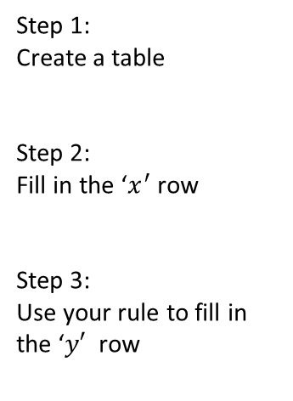


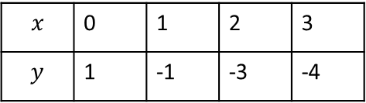
24
7
30
Topic: Linear Relationships
Date
EQ – How do you find and use the rule for a linear relationship?
How do I turn an equation into a graph?
Example:
$$y=−2x+1$$
Step 1:
Create a table
Step 2:
Fill in the ‘$x^{′}$ row
Step 3:
Use your rule to fill in the ‘$y′$ row
$$x$$ | 0 | 1 | 2 | 3
$$y$$ | 1 | -1 | -3 | -4
$$x= 0$$
$$y=1$$
$$x=1$$
$$y= −2×\left(1\right)+1$$
$$y=−1$$
$$x=2$$
$$y= −2×\left(2\right)+1$$
$$Y=−3$$
$$x=2$$
$$y= −2×\left(3\right)+1$$
$$y=−5$$

Slide 7
You need to higher an electrician to install new cables ring around to get some quotes.
quote 1 = $100 call out fee + $40 per hour
quote 2 = $150 call out fee and $35 per hour
quote 3 = $50 call out fee and $50 per hour
So which is cheapest?
Well that depends on how long it takes.

Slide 8
You need to hire an electrician to install new cables . The quote comes back as;
Cost = $40 per hour + $100 call out fee
So how much will it cost?
We can use our quote to create a table.
eg. Cost = $40 per hour + $100 call out fee
x (hours) | 0 | 1 | 2 | 3 | 4 | 5 | 6
y (cost)
100 | 140 | 180 | 220 | 260 | 300 | 340

Slide 9

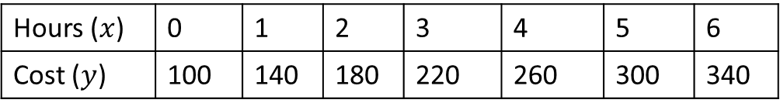
Lets have a look at our table and our rule and look for how they work together
Cost = $40 per hour + $100 call out fee
$$y=40x+100$$
Hours ($x$) | 0 | 1 | 2 | 3 | 4 | 5 | 6
Cost ($y$) | 100 | 140 | 180 | 220 | 260 | 300 | 340
+$40
+$40
+$40
+$40
+$40
+$40
What 2 things do we see?
1. Every 1 hour our cost increases by $40

Slide 10

Lets have a look at our table and our rule and look for how they work together
Cost = $40 per hour + $100 call out fee
$$y=40x+100$$
Hours ($x$) | 0 | 1 | 2 | 3 | 4 | 5 | 6
Cost ($y$) | 100 | 140 | 180 | 220 | 260 | 300 | 340
+$40
+$40
+$40
+$40
+$40
+$40
What 2 things do we see?
1. Every 1 hour our cost increases by $40
2. At time = 0 we are charged $100

Slide 11

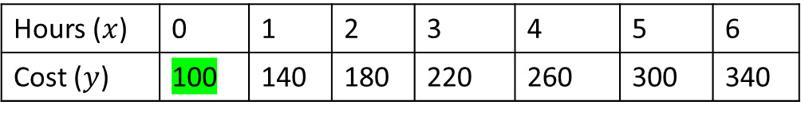
Lets have a look at our table and our rule and look for how they work together
Cost = $40 per hour + $100 call out fee
$$y=40x+100$$
Hours ($x$) | 0 | 1 | 2 | 3 | 4 | 5 | 6
Cost ($y$) | 100 | 140 | 180 | 220 | 260 | 300 | 340
+$40
+$40
+$40
+$40
+$40
+$40
What 2 things do we see?
This increase is called the gradient
1. Every 1 hour our cost increases by $40
2. At time = 0 we are charged $100
The start position is the y-intercept
We can use the same method to find a rule for any linear equation

